Slide 1




"Using data to drive product-led growth in decision-making "
Rachael Shitanda
Head of Product Research , Rs Maray and
Product Management Mentor @Adplist

Slide 2


Introduction to Product-Led Growth (PLG) and why data is important in decision-making
bit.ly/wtmmembership
Notes:
Stay connected with Women Techmakers by joining the Member program today. By becoming a member you’ll get:
Curated content - Regular emails tailored to your interests to help you succeed and thrive in your tech career, featuring resources from Women Techmakers, Google, and the global tech ecosystem.
Early access: First look and special announcements for upcoming events and more.
Community: Connect with a global network of women in technology.
Link for sign up: bit.ly/wtmmembership

Slide 3
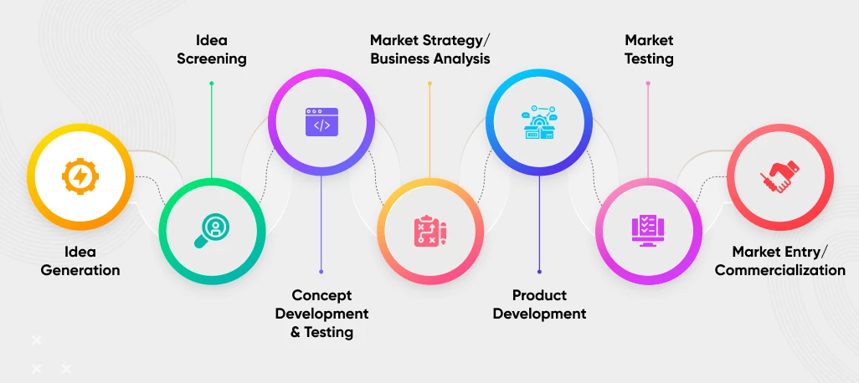
Product Development lifecycle

Slide 4

Introduction to Product-Led Growth (PLG) and why data is important in decision-making
Introduction to Product-Led Growth (PLG)
Why Data is Important in Decision-Making
Key Metrics to Measure for PLG

Slide 5
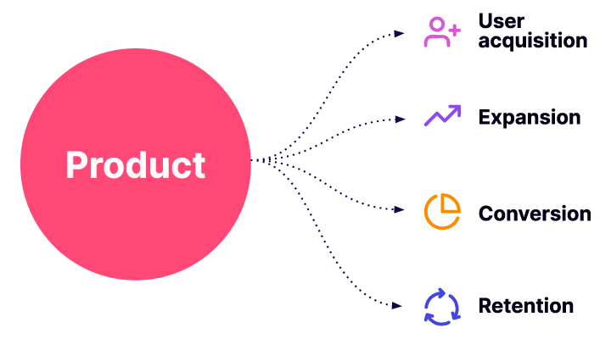
Introduction to Product-Led Growth (PLG)
Product-Led Growth (PLG) is a business strategy that focuses on using the product itself to drive growth and customer acquisition, rather than relying on traditional marketing and sales tactics. It involves creating a product that is intuitive, user-friendly, and provides value to customers from the very beginning of their journey with the product.

Slide 6
Why Data is Important in Decision-Making?
Data is essential in PLG decision-making, as it helps businesses to understand user behavior, preferences, and needs. This information can be used to optimize the product and improve the customer experience, which in turn drives growth.
Notes:
Stay connected with Women Techmakers by joining the Member program today. By becoming a member you’ll get:
Curated content - Regular emails tailored to your interests to help you succeed and thrive in your tech career, featuring resources from Women Techmakers, Google, and the global tech ecosystem.
Early access: First look and special announcements for upcoming events and more.
Community: Connect with a global network of women in technology.
Link for sign up: bit.ly/wtmmembership

Slide 7




Key Metrics to Measure for PLG.
Activation Rate: the percentage of users who complete a specific action within the product (e.g., sign up, make a purchase)

Slide 8
Key Metrics to Measure for PLG.
Retention Rate: the percentage of users who continue to use the product over time

Slide 9
Key Metrics to Measure for PLG.
Net Promoter Score (NPS): a measure of customer satisfaction and loyalty

Slide 10
Key Metrics to Measure for PLG.
Customer Acquisition Cost (CAC): the cost of acquiring a new customer through marketing and sales efforts.

Slide 11
Types of Data Used in Product-Led Growth (PLG)

Slide 12
Types of Data Used in Product-Led Growth (PLG)
Behavioral Data
Demographic Data
Psychographic Data
Customer Feedback Data
Usage Data

Slide 13
Behavioral Data
This type of data refers to how users interact with the product. It includes information such as the features they use, the pages they visit, and the actions they take. Behavioral data helps businesses understand user behavior and preferences, which can be used to optimize the product and improve the customer experience
Notes:
Stay connected with Women Techmakers by joining the Member program today. By becoming a member you’ll get:
Curated content - Regular emails tailored to your interests to help you succeed and thrive in your tech career, featuring resources from Women Techmakers, Google, and the global tech ecosystem.
Early access: First look and special announcements for upcoming events and more.
Community: Connect with a global network of women in technology.
Link for sign up: bit.ly/wtmmembership

Slide 14
Demographic Data
This type of data refers to users' basic characteristics, such as age, gender, location, and occupation. Demographic data helps businesses understand their target audience and create targeted marketing and sales campaigns.
Notes:
Stay connected with Women Techmakers by joining the Member program today. By becoming a member you’ll get:
Curated content - Regular emails tailored to your interests to help you succeed and thrive in your tech career, featuring resources from Women Techmakers, Google, and the global tech ecosystem.
Early access: First look and special announcements for upcoming events and more.
Community: Connect with a global network of women in technology.
Link for sign up: bit.ly/wtmmembership

Slide 15
Psychographic Data
This type of data refers to users' personality traits, values, interests, and attitudes. Psychographic data helps businesses understand user motivations and preferences, which can be used to tailor the product to their needs.
Notes:
Stay connected with Women Techmakers by joining the Member program today. By becoming a member you’ll get:
Curated content - Regular emails tailored to your interests to help you succeed and thrive in your tech career, featuring resources from Women Techmakers, Google, and the global tech ecosystem.
Early access: First look and special announcements for upcoming events and more.
Community: Connect with a global network of women in technology.
Link for sign up: bit.ly/wtmmembership

Slide 16
Customer Feedback Data
This type of data refers to feedback provided by users, either through surveys, reviews, or customer support interactions. Customer feedback data helps businesses understand user satisfaction and identify areas for improvement.
Notes:
Stay connected with Women Techmakers by joining the Member program today. By becoming a member you’ll get:
Curated content - Regular emails tailored to your interests to help you succeed and thrive in your tech career, featuring resources from Women Techmakers, Google, and the global tech ecosystem.
Early access: First look and special announcements for upcoming events and more.
Community: Connect with a global network of women in technology.
Link for sign up: bit.ly/wtmmembership

Slide 17
Usage Data
This type of data refers to how frequently users interact with the product and how long they spend using it. Usage data helps businesses understand user engagement and retention, which are critical for PLG success
Notes:
Stay connected with Women Techmakers by joining the Member program today. By becoming a member you’ll get:
Curated content - Regular emails tailored to your interests to help you succeed and thrive in your tech career, featuring resources from Women Techmakers, Google, and the global tech ecosystem.
Early access: First look and special announcements for upcoming events and more.
Community: Connect with a global network of women in technology.
Link for sign up: bit.ly/wtmmembership

Slide 18
Examples of data-driven decision-making in PLG

Slide 19


Identifying Feature Usage Patterns:
By analyzing behavioral data, businesses can identify which features are most frequently used by users and which are underutilized. This information can be used to optimize the product by prioritizing development of the most popular features and improving or removing less popular ones.

Slide 20
Optimizing Onboarding Process:
By analyzing usage data and customer feedback data, businesses can identify pain points and areas for improvement in the onboarding process. This information can be used to optimize the onboarding process and make it more intuitive, reducing user churn and improving user engagement.

Slide 21
Improving User Engagement:
By analyzing usage data and behavioral data, businesses can identify patterns in user engagement and identify users who are at risk of churning. This information can be used to send targeted messages and incentives to improve user engagement and retention.

Slide 22
Personalizing the User Experience:
By analyzing demographic data and psychographic data, businesses can create personalized user experiences that cater to the unique needs and preferences of each user. This can include personalized product recommendations, customized messaging, and targeted marketing campaigns.

Slide 23
Common pitfalls in using data in decision-making
Overreliance on Data
Confirmation Bias
Incomplete or Inaccurate Data
Lack of Context
Failure to Act on Data

Slide 24
Types of Tools used in PLG
Business Intelligence (BI) Tools e.g. Tableau, Power BI, and Google Data Studio.
Customer Relationship Management (CRM) Software e.g. Salesforce, HubSpot, and Zoho CRM
Web Analytics Tools e.g. Google Analytics, Mixpanel, and Heap
A/B Testing Tools e.g. Optimizely, VWO, and Google Optimize
Heat Mapping Tools e.g. Hotjar, Crazy Egg, and Clicktale
Collaboration tools

Slide 25
Business Intelligence (BI) Tools
Data visualization tools - These tools allow product managers to create visualizations of their data to better understand trends and patterns. Examples include Tableau, Power BI, and Google Data Studio.

Slide 26
Customer Relationship Management
(CRM)
Customer feedback tools - These tools allow product managers to collect feedback from customers and users to better understand their needs and preferences. Examples include UserVoice, Qualtrics, Salesforce, HubSpot, and Zoho CRM and SurveyMonkey.

Slide 27
Web Analytics Tools
These tools allow product managers to track key metrics and KPIs, such as user behavior, engagement, and revenue. Examples include Google Analytics, Mixpanel, Heap and Amplitude.

Slide 28
A/B testing tool
These tools allow product managers to test different versions of a product or feature to see which performs better. Examples include Optimizely, VWO, and Google Optimize.

Slide 29
Collaboration tools
These tools allow product managers to collaborate with other stakeholders, such as designers, developers, and marketers, to make data-driven decisions together. Examples include Asana, Trello, and Slack.

Slide 30




Best practices for using data in decision-making

Slide 31

Key best practices and real-world examples that illustrate the power of data-drive` n decision-making:
Set clear goals
Collect and analyze data
Prioritize based on impact
Build a data-driven culture

Slide 32
In Conclusion:
Data is essential for making informed decisions in Product-Led Growth (PLG)
Businesses should use a variety of data sources and tools to gather, analyze, and act on insights
Clear objectives, effective analysis, multiple perspectives, and continuous monitoring are key best practices for using data in decision-making
Data-driven decision-making can help businesses drive growth, improve the user experience, and achieve their business goals
Notes:
Stay connected with Women Techmakers by joining the Member program today. By becoming a member you’ll get:
Curated content - Regular emails tailored to your interests to help you succeed and thrive in your tech career, featuring resources from Women Techmakers, Google, and the global tech ecosystem.
Early access: First look and special announcements for upcoming events and more.
Community: Connect with a global network of women in technology.
Link for sign up: bit.ly/wtmmembership

Slide 33
"The goal is to turn data into information, and information into insight." - Carly Fiorina, former CEO of Hewlett-Packard.

Slide 34
"Without data, you're just another person with an opinion." - W. Edwards Deming.

Slide 35

THANK YOU!

